Slide 1
Welcome at TH OWL
Membership in a German Health Insurance: mandatory or exempted?
Notes:
Session 21/08/2024

Slide 2
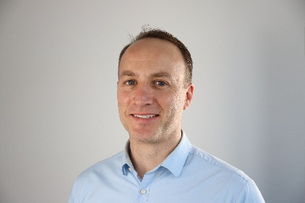
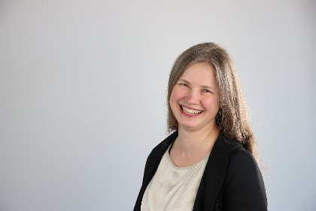
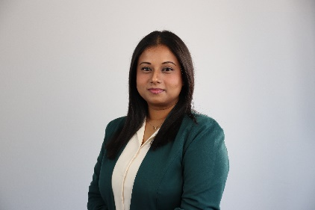
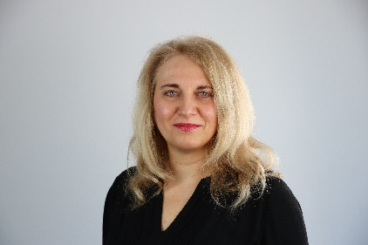
International Office
James O'Reilly
Head International Office
Anne Kulasi
Erasmus Coordinator
Ananya Nagendran
Coordinator QualifyING
Anamaria Capsa
Coordinator for Refugee Program NRWege and Welcome | German language courses
https://www.th-owl.de/international/kontakt/

Slide 3
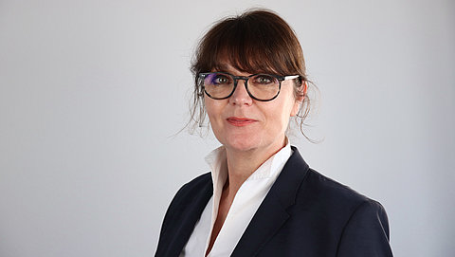
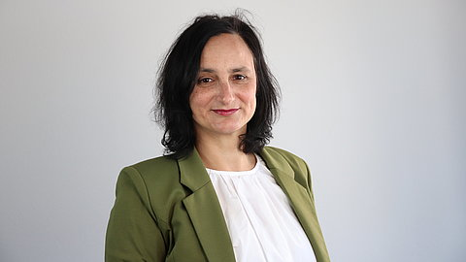
Maryse Niemeier
Kerstin Rosemann
Campus Detmold
Consultant Outgoing/Incoming
Room 4.109 – „Bülow Block“
Phone +49 5231 7696091
E-Mail: maryse.niemeier@th-owl.de
On campus: Tues – Thurs: 9.00 – 13.00 h
Home office: Mon - Fri
Campus Lemgo & Höxter
Consultant Incoming
Room 1.117
Phone +49 5261 702 5836
E-Mail: kerstin.Rosemann@th-owl.de
On campus: Mon & Thu: 9.00 – 15.00 h
Home office: Tue, Wed and Fri

Slide 4
German Health insurance compulsary for students below 30
Proof of health insurance for students below 30 is mandatory (German law)
Electronic process between the health insurance company and the university via KIS
A statutory health insurance is required - no private health insurance

Slide 5
Exemption from compulsory health insurance | Students over 30
Statutory health insurance no longer mandatory
No benefit of low student rates at statutory health insurance companies
Take out voluntary insurance with one of the statutory health insurance companies.
Alternative: private health insurance (watch out for a good cover!)
Information website Deutsches Studierendenwerk: https://www.internationale-studierende.de/en/on-arrival/health-insurance

Slide 6
First aid dictionary and doctor search directory
Search for doctors and psychotherapists by specialty and language skills

Slide 7
Subsequent information events offered by
Techniker Krankenkasse (TK)
Wednesday, 28. August 2024 (14.00 – 15.00)
You can find out from our cooperation partner Techniker Krankenkasse (statutory health insurer) in its info session "Well prepared for your studies – Health insurance in Germany" more information
registration: TK Infosession

Slide 8
Next Infosession
Wednesday, 4 September 2024 (12:00 – 13:30) Scholarship opportunities - financing your studies in Germany – In this online session, we will introduce TH OWL scholarship programs offered for international students. You will also find out about job regulations being on a study visa.
Student representatives at TH OWL - Valuable Peer – Peer advice

Slide 9
Thank You!
Please feel free to ask questions by raising your hand or in the chat ☺

