Slide 1
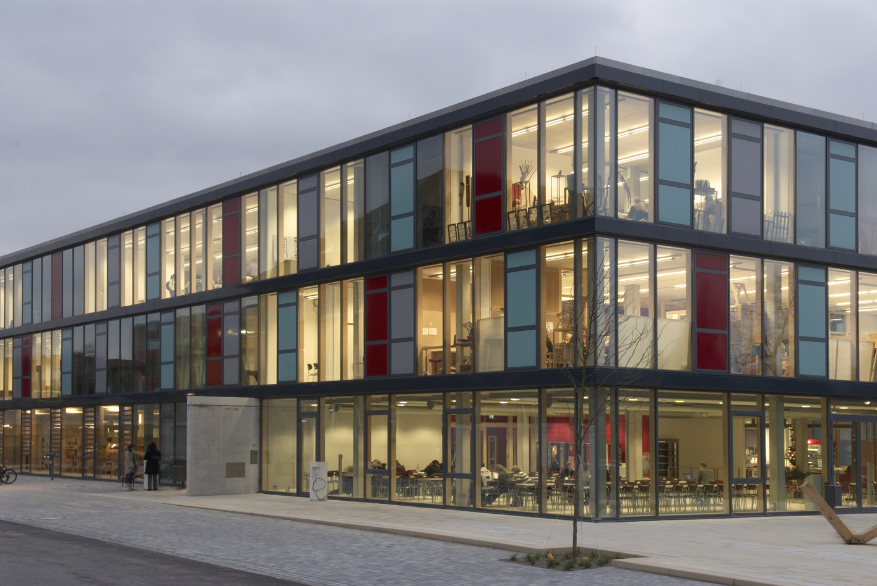
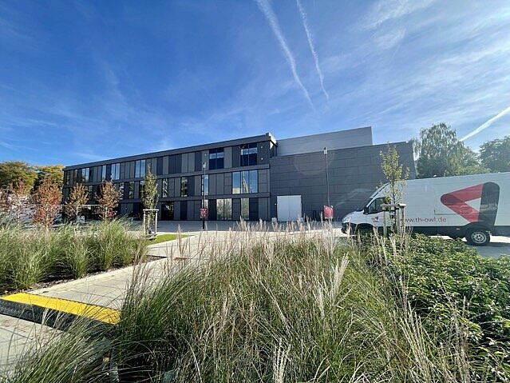
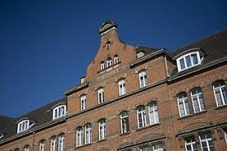
Welcome to TH OWL University of Applied Sciences and Arts - Campus Detmold -
Detmold school of Design
Detmold School for Design
Media Production Faculty
Civil Engineering Faculty
https://vimeo.com/377550392
https://youtu.be/Dn_NP6BFKwg
https://www.youtube.com/watch?app=desktop&v=LZSuDviF1Wc

Slide 2
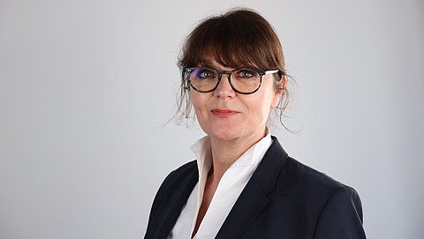
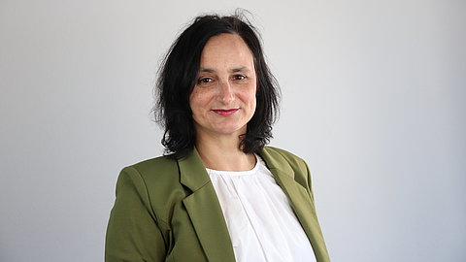
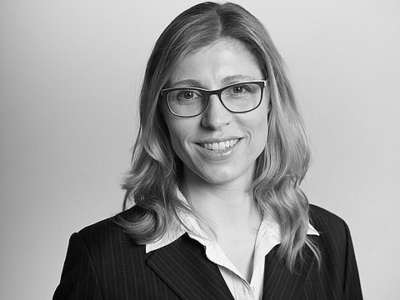
Contact persons for Internationals
Maryse Niemeier
Kerstin Rosemann
Sandra Bomholt
Campus Detmold
Consultant Outgoing/Incoming
Room 4.109 – „Bülow Block“
Phone +49 5231 7696091
E-Mail: maryse.niemeier@th-owl.de
On campus: Tues – Thurs: 9.00 – 13.00 h
Home office: Mon - Fri
Campus Lemgo & Höxter
Consultant Incoming
Room 1.117
Phone +49 5261 702 5836
E-Mail: kerstin.Rosemann@th-owl.de
On campus: Mon & Thu: 9.00 – 15.00 h
Home office: Tue, Wed and Fri
International Services
Detmold School of Design
Room: 4.110 |
Fon: +49 (0) 5231 / 769-5332
E-Mail: sandra.bomholt@th-owl.de

Slide 3

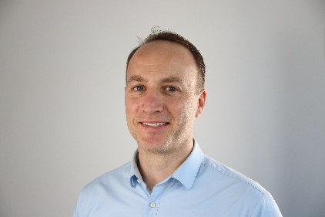
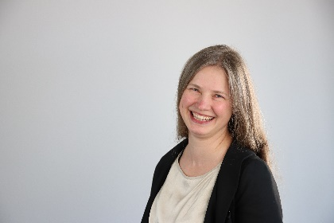
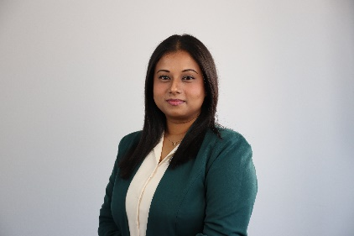
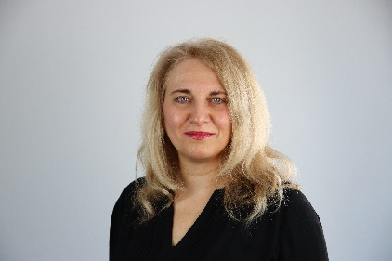
International Office
James O'Reilly
head International Office
Anne Kulasi
Erasmus coordinator
Ananya Nagendran
Coordinator QualifyING
Anamaria Capsa
coordinator for NRWege program | German language courses
https://www.th-owl.de/international/kontakt/

Slide 4
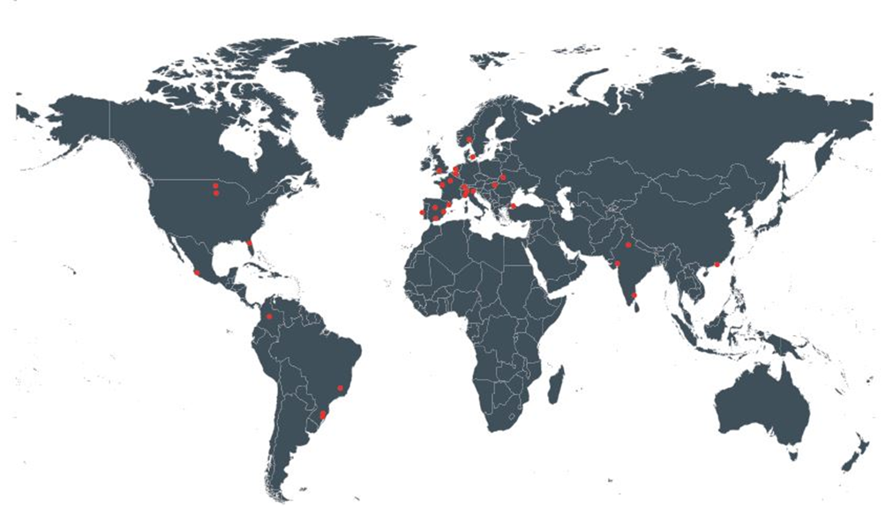
International Students from all over the world
Exchange Students from Universiti Tunku Abdul Rahman, Malaysia | Kültür University, Istanbul, Turkey | Tongm Yong University, Korea | K‘Arts, Seoul, Korea | German Jordanian University, Amman, Jordan
Degrees from Egypt, Albania, Syria, Bangladesh, Brazil, Ecuador, India, Indonesia, Iran, Cameroun, Morocco, Mexico, Nepal, Nigeria, Austria, Polen, Russia, Turkey, Ukraine

Slide 5
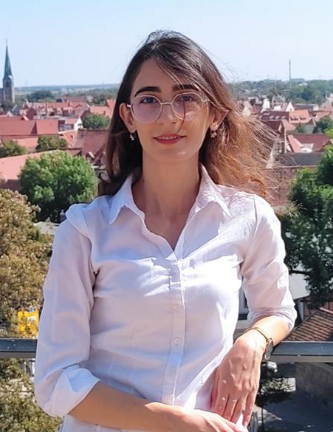
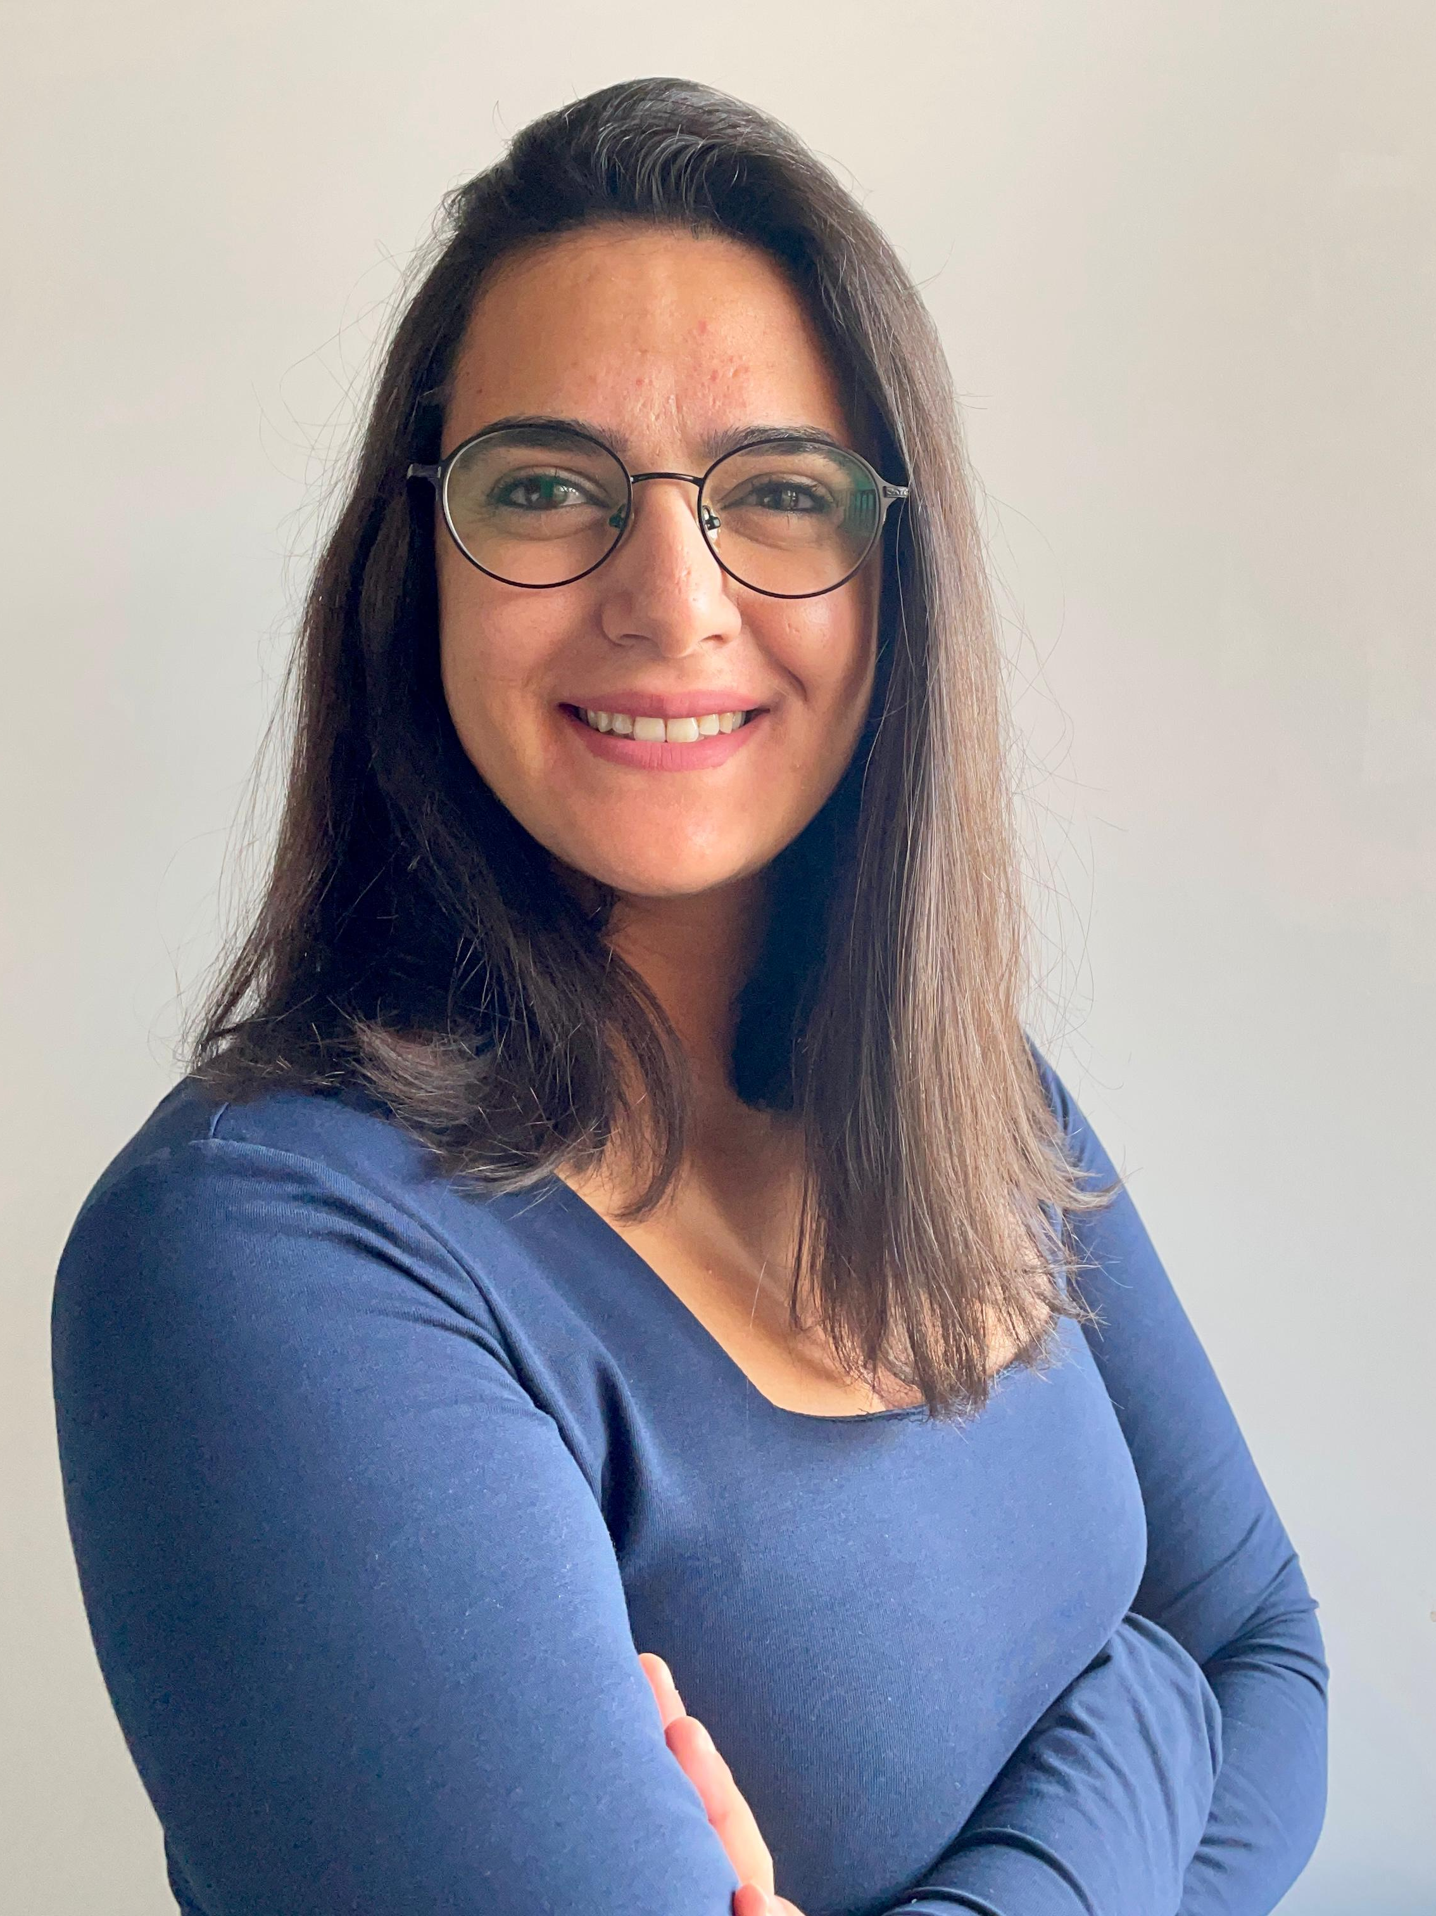
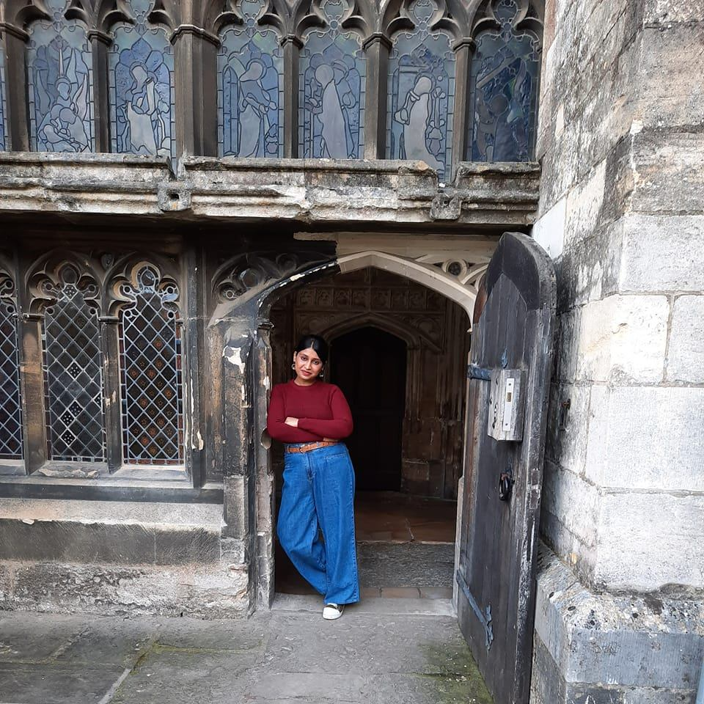
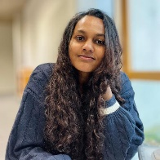
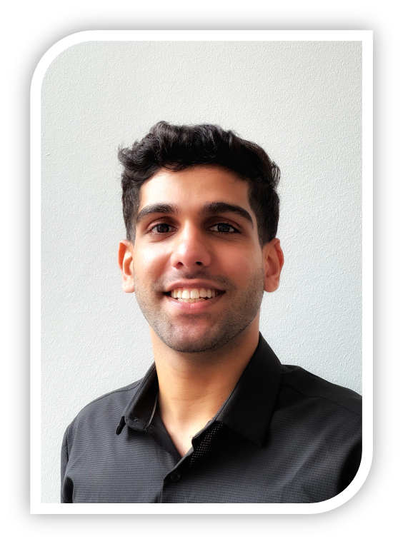
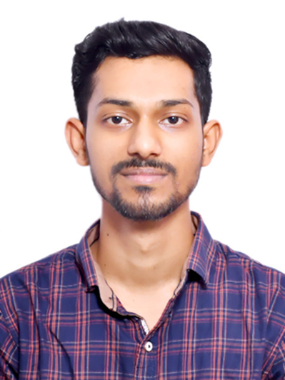
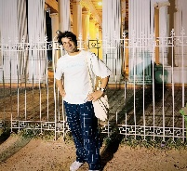
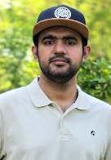
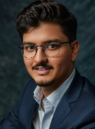
I.O. Student Representative:
Buddy Team
Marie Al Helou (MID – Campus Detmold)
Sara Hemmatyar (MID – Campus Detmold)
Kavyashree Govil (MID – Campus Detmold)
Hanna Steinhörster (Media Production – Campus Detmold)
Tharindi Hewawasam (Master IT – Campus Lemgo)
Abhishek Arora (Master Entrepreneurship – Campus Lemgo)
Shayan Naveed (Master IT – Campus Lemgo)
Kunal Chandolkar (Master IT – Campus Lemgo)
Ajith Sunny (Master IT – Campus Lemgo)
Harsh Paliya (Master IT – Campus Lemgo)

Slide 6

GENERAL INFORMATION

Slide 7
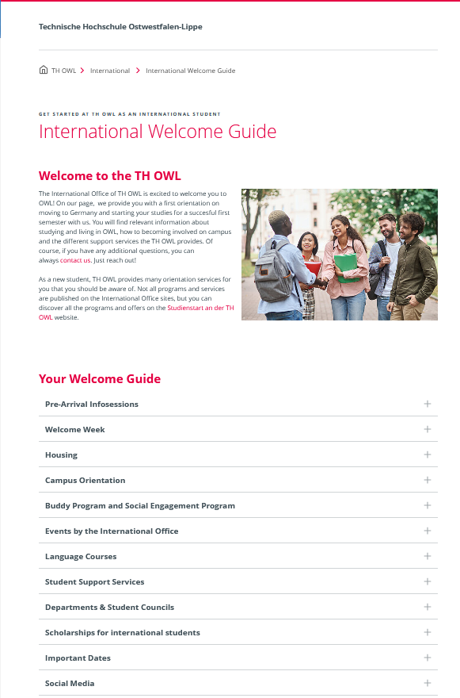
International welcome Guide
link

Slide 8
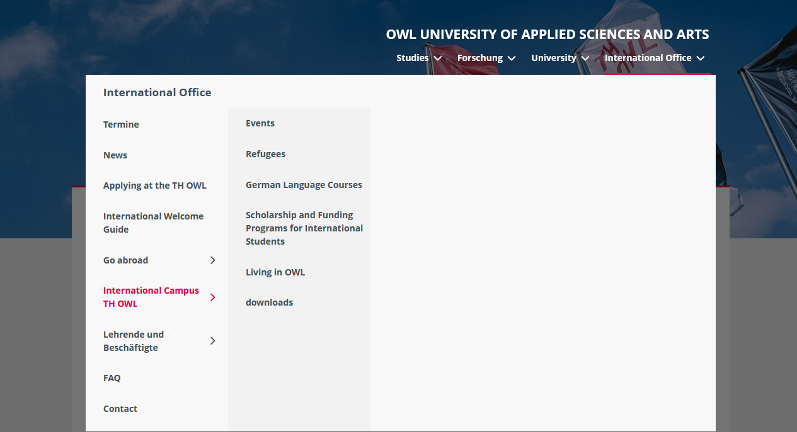
International Campus TH OWL

Slide 9
Semester lecture period
 |  | Von bis
Wintersemester | 2025/26 | 22.09.2025 – 06.02.2026
Sommersemester | 2026 | 06.04.2026 - 31.07.2026
Wintersemester | 2026/27 | 28.09.2026 - 12.02.2027
Sommersemester | 2027 | 29.03.2027 - 23.07.2027
Wintersemester | 2027/28 | 27.09.2027 – 11.02.2028
Sommersemester | 2028 | 03.04.2028 - 28.07.2028
Wintersemester | 2028/29 | 25.09.2028 - 09.02.2029
Sommersemester | 2029 | 26.03.2029 - 20.07.2029
Wintersemester | 2029/30 | 24.09.2029 - 08.02.2030
Sommersemester | 2030 | 19.03.2030 - 12.07.2030

Slide 10
Check list: What you have to do after your arrival
Open or activate your bank account | Opening a bank account is free of charge for students (up to 25 or 27 yrs. old). A German bank account is absolutely necessary for: monthly payments like room rent, health insurance. Before departing home you need to close the account in person.
Transfer the semester fee of 334,80 € if not yet transferred | If you transfer the amount from abroad be sure to include the transfer fee for your bank
Enrolment if not yet done. | The enrolment fee includes our so-called semester ticket which you can use for free public transport in Germany.
German public health insurance | Mandatory for studying at German universities for student under 30. The monthly fee is approx. 110,- €.
Register at the Town Hall of the city your living in Appointement for Detmold city Hall here: https://timeacle.com/booking/company/stadt-detmold/branch/stadt-detmold/queue/burgerberatung/summary Important: When you leave Germany: don’t forget to deregister!!! | To the appointment you need to bring: Passport Visa The “Wohnungsgeberbestätigung” (can be fulfilled online by your Landlord Where: Detmold: Bürgerberatung, Paulinenstraße 25 Wednesday without appointments
Apply for your Electronic Residence Permit (only for NON EU Students) Immigration Service City of Detmold auslaenderbehoerde@detmold.de or Kreis Lippe auslaenderamt@kreis-lippe.de Important: When you leave Germany: don’t forget to deregister!!! | You need to bring: Admission letter TH OWL, Student Card Passport + 1 photo Certificate of registration in your City Rental contract, proof of health insurance, proof of being able to finance your studies (bank statements/blocked account) fees: 100,- € in cash
Download your semester ticket How to get your semester ticket ? https://www.th-owl.de/skim/dokumentation/semesterticket/ | The Germany Semester Ticket is available to students in OWL via the OWLmobil app. You can download the app for free from the Google Play Store (Android) or App Store (iOS). https://teutoowl.de/pdf/news/OWL-Verkehr_Get-your-deutschlandsemesticket_Instructions.pdf

Slide 11
Semesterticket: Deutschlandsticket
According to the operator OWL Verkehr, the Deutschlandsemesterticket must only be shown in the app. A printout of the screen content is not sufficient.
Please be sure to observe the transport conditions of the participating transport associations.
Please find out before you start your journey whether the Deutschlandsemesterticket is valid on the route you are planning to take.
For example, long-distance routes (IC/ICE) or routes operated by private operators are often excluded. Bicycles are also not included in the Germany Semester Ticket.
How to set up the "owlMOBIL" app
The "owlMobil" app is the basic requirement for usage of the Deutschlandsemesterticket. Students install it on their mobile device and use it to manage the ticket. The app is available here:
Link to the Google Play Store (Android)
Link to the Apple-Store (Apple iOS)

Slide 12
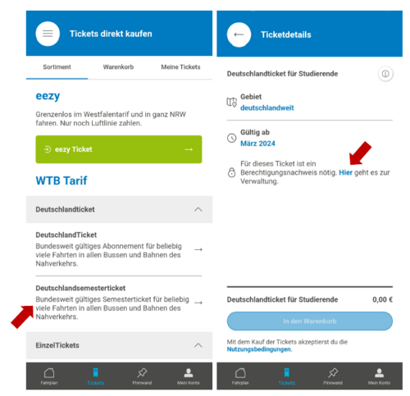
D-Semesterticket: how to provide it?
https://teutoowl.de/pdf/news/OWL-Verkehr_Get-your-deutschlandsemesticket_Instructions.pdf

Slide 13
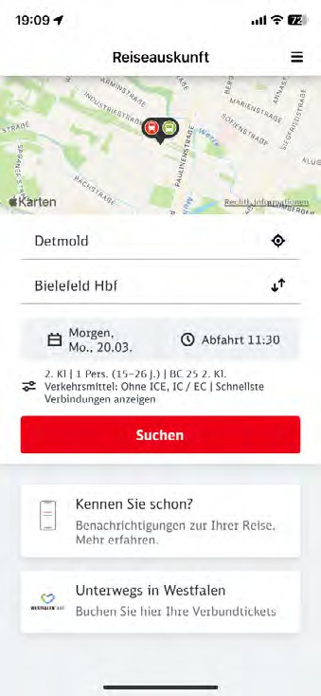
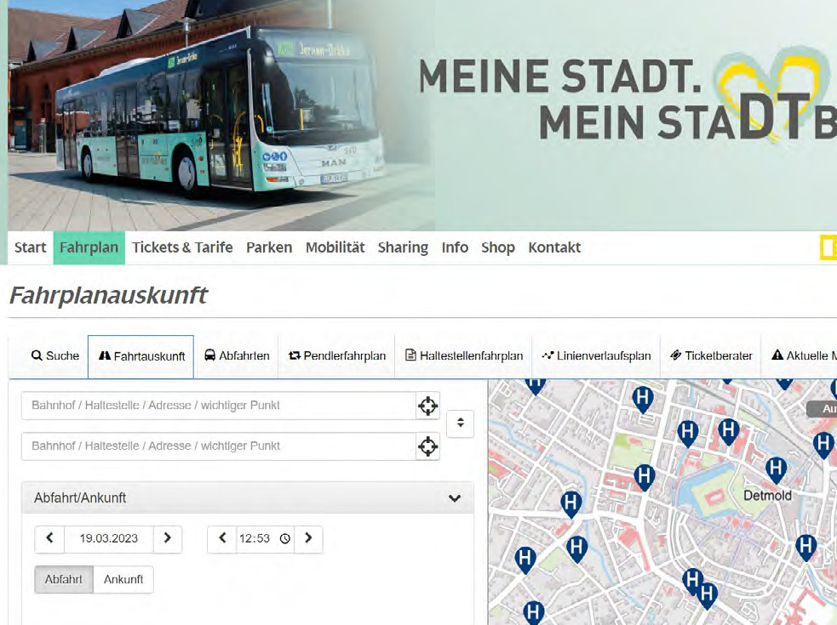
Semesterticket: Detmold City
Always enter the bus through the first door and show your ticket to the driver. If you want to exit, you‘ll need to press one of the buttons to let the driver know that he should stop at the next bus stop.
timetable and road map: https://www.stadtverkehr-detmold.de/fahrplan/fahrplanauskunft or simply use the app „DB Navigator“

Slide 14
Check list: What you had to do on Campus
Activate your personal TH OWL user account – Gain access to numerous electronic services • Wireless networks • E-mail • Cloud • Library services | Activation URL: https://idm.th-owl.de/sspr/public/ActivateUser • Username: e.g. abc-123 • Activation password: xxxxxxxxx (You received your username and activation password from enrolment service) Important: In the activation process you have to assign your own password and answer security questions.
Electronic Services and E-mail account With your activated user account, you can access all electronic services • The learning platform • Library services • Wireless network and more | Activate your official university e-mail account: • Webmail URL: https://webmail.th-owl.de/ E-mail address: first name.surname@stud.th-owl.de • Username: "Your username from point 1“ • Password: "The one you assigned during activation“ Important: we will communicate with you via your university email address. Please read your e-mails regularly
Enrolment certificate (study certificate / Studienbescheinigung) | The certificates can be accessed by the students themselves via their KIS Portal Account
Apply for your Campus ID card (KISOWL) https://www.th-owl.de/skim/dokumentation/campuscard-kisowl/ | The Campuscard (KISOWL) is your student ID, library ID and cashless payment method in one. With this card you can: • Upload money to pay in the canteens at all university locations, • ID for borrowing and renewing books and other media, as well as pay for services in all campus library locations. You can obtain your card immediately from our contact points in the library on Campus Detmold

Slide 15
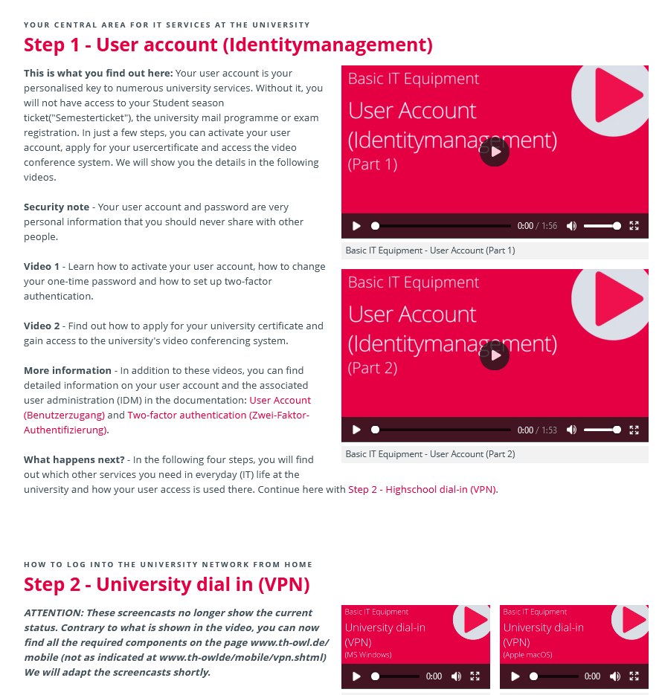
(IT) Basics at the start of studies
https://www.th-owl.de/en/skim/documentation/basic-it-equipment-at-the-start-of-your-studies/

Slide 16

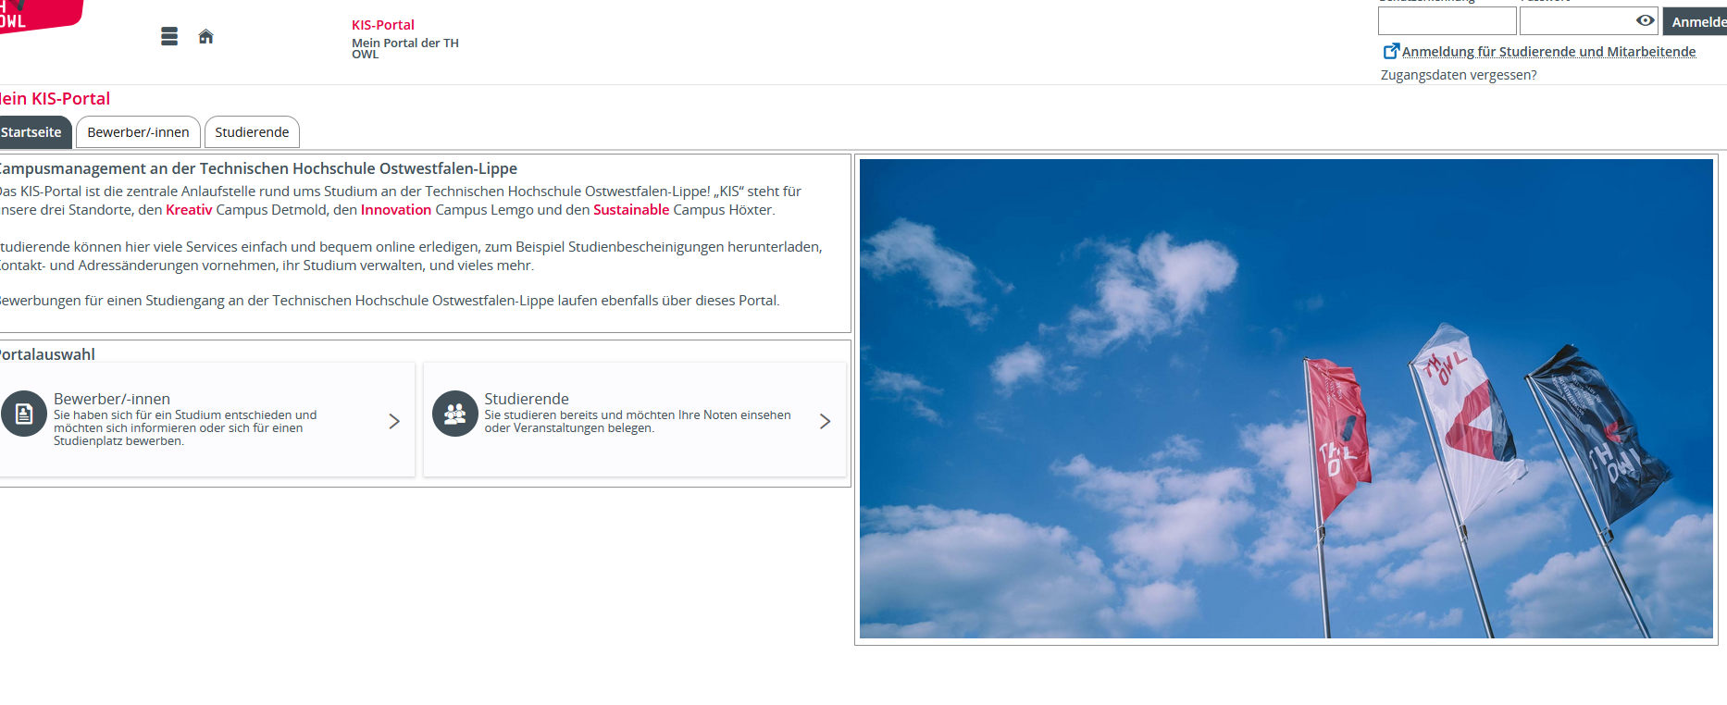
Access to your KIS Portal
https://kis-portal.th-owl.de/qisserver/pages/cs/sys/portal/hisinoneStartPage.faces

Slide 17
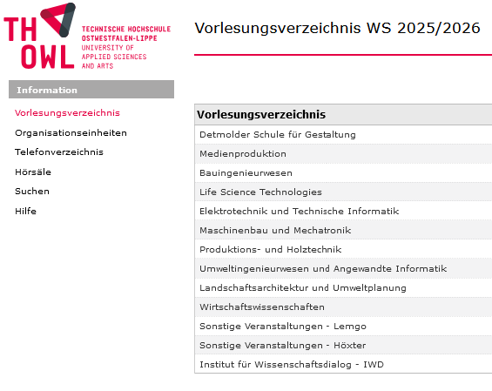
Campus Management – courses schedule
What is CAS Campus?
The Campus Management System - CAS Campus displays the current semesters and individual courses of almost all departments and organizational units of TH OWL under the menu item "Lecture list“ (Vorlesungsverzeichnis) .
Technical requirements
Please note that proper use of the functions can only be guaranteed with the following Internet browsers:
Mozilla Firefox (Our recommendation)
Microsoft Internet Explorer Version 11
Microsoft Edge
Google Chrome
The Apple Safari browser is not approved by CAS.
https://www.th-owl.de/cm/campus/all/fields.asp?tguid=0xA70A4E0F4A9A4C10940E341DABAB6BAE&lang=de

Slide 18
Little surprises
BROADCASTING LICENCE FEE (RUNDFUNKBEITRAG) FOR STUDENTS | In Germany, every household must pay abroadcasting license fee of €18.36 per month to finance the public broadcasters ARD, ZDF, and Deutschlandradio. This fee is charged per household and applies regardless of whether you use a television or radio. The contribution service of ARD, ZDF, and Deutschlandradio is responsible for collecting the fee and provides information on registration, payment, and possible exemptions or reductions. I share a flat. Who pays? Only one person must be registered and pay the licence fee for the flat. Residents of a shared flat can decide among themselves who this should be. Any other residents who already have a licence fee account may deregister.
Telephone Providers | Generally, there are two different options to make phone calls – either using a landline or a mobile phone. Students often prefer mobile phones, as many providers offer lower student rates on pay-as-you-go SIM cards or fixed-term contracts with monthly rates. For international students staying abroad for a shorter amount of time, it is advisable to use the pay-as-you-go option, because you are not bound to a fixed-term contract, which makes it easier to control expenses. Should students wish to use a SIM card from their home country, it is very important to check the phone charges for using the SIM card in Germany beforehand, as it is possible that high user fees may be charged. Usually, it is cheaper to use a German SIM card. Ex. Aldi Talk

Slide 19





Plan Kreativ Campus Detmold
Emilienstraße 45 und Bielefelder Straße 66, 32756 Detmold
P
6
P
2
Mensa
P
direction Bielefeld Autobahn A2
P
1
Kissinger Straße
Haupteingang
8
Bielefelder Straße
5
4
Richtung Detmold Bahnhof
₃ Café 45
P
H
Emilienstraße
7
Bielefelder Straße
H
Gutenbergstraße
Faculty civil Engineering, Administation, lecture rooms
„Riegel“, Faculty Detmold design School, Canteen, Library, administration, Workshops, lecture halls, seminar rooms
„Casino“, Lecture halls, Café 45
„Bülow-Block“, “, Faculty Detmold design School seminar rooms
Faculty civil Engineering, Labs, Work Hall
childcare „Paulinchen“, ASt A-Shop
Faculty Media Production
KreativInstitut.OWL
direction
Detmold city center Paderborn Autobahn A44
Barriere free Entrances
Barriere free Entrances
*kurzfristige Änderungen vorbehalten | Stand 09/2023

Slide 20
Important contacts on campus

Slide 21

AStA „General Students‘ Committee)
student self-administration - by students for students.
at all 3 locations
Represents the interests of the students
Offers sports activities, evening programs, store for study supplies, rental of the AStA van, ...
Fachschaften (Students‘ council)
In university politics, students can have a say in what happens at their university!
The student representatives are there to help the members of their department in their day-to-day studies.
They serve as a point of contact for problems and conflicts within the course of study and organize events and offers of the respective department, such as get-to-know-each-other evenings for first semester students.
Contact and information: https://www.th-owl.de/international/international-student-guide/#c-accordion-84972-8

Slide 22

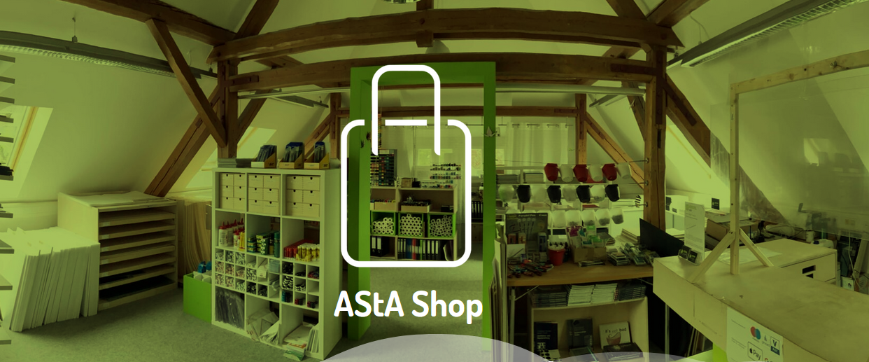
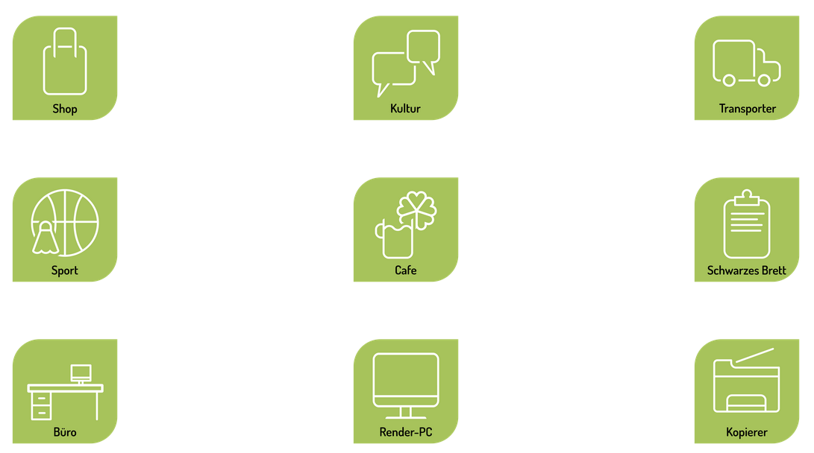
ASTA Detmold (General Students' Committee)
Asta shop: to buy all the supplys you need for your study (Building 6, roof floor)
Contact: shop@asta-detmold.de
Opening time: Mo and Fr.: closed – Tu. 09:00 – 11:00 – wedn. 11:30 – 13:00 Thu. 12:30 – 14:30
Asta Sport (Pilates, basket ball, Fitness, Yoga …):
Contact sport@asta-detmold.de
Asta Office: meeting with the Asta‘s members and ask for the activities (Building 1, 1.014)
Asta café: Enjoy a drink in the noon between 2 courses (Building 2, 2nd floor)
Asta Auslandsreferat:
contact: ausland@asta-detmold.de
Internet: https://detmold.asta-owl.de/
Instagram: https://www.instagram.com/asta_detmold/

Slide 23

Student committees
Represent the students interests
Communication with professorsWelcome week, workshops, barbecues, ice cream bar, partys, ...
contact:
Detmold School of Design
fachschaft.fb1@th-owl.de
https://www.th-owl.de/gestaltung/fachbereich/studentische-gremien/fachschaft/
https://www.instagram.com/fachschaft.fb1
Media Production:
fachschaft.fb2@th-owl.de
https://www.th-owl.de/medienproduktion/fachbereich/fachschaft/
https://www.instagram.com/fachschaft.fb2/
Civil Engineering:
https://www.th-owl.de/bauingenieurwesen/fachbereich/gremien/#tab-c48079-5
fachschaft.fb3@th-owl.de
https://www.instagram.com/fachschaft.fb3/?hl=de

Slide 24

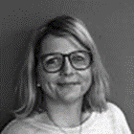
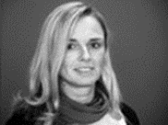
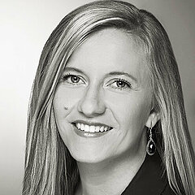


Examination offices in Detmold
Media production
Martina Wallbaum
Room 7.308,
Tel.: +49 5231 769 3203
E-Mail: pruefungsamt.fb2@th-owl.de
Bachelor Architecture
Master MArch
Sandra Schneider Room: 2.104 | Fon: (05231) 769-6861
email: sandra.schneider@th-owl.de
Bachelor Urban Planning
Master MID and MUPST
Ina Klassen
Room: 2.116 | Fon: (05231) 769-6106
E-Mail: ina.klassen(at)th-owl.de
Bachelor Interior Architecture
Master MIAR
Ann-Christin Pott Room: 2.105 | Fon: (05231) 769-6712 email: ann-christin.pott@th-owl.de Bachelor Civil Engineering
Master Infrastrukturmanagement – Wasser und Verkehr and
Master Konstruktiver Ingenieurbau und digitale Bauprozesse
Christine Adalbert Room 1.120 | Fon: (05231) 769 3303 email: christine.adalbert@th-owl.de

Slide 25
German Courses for international students
One A1.2/A2.1 course will be offered in the winter semester 2025.
Registration: anamaria.capsa@th-owl.de until 15.09.2025
https://www.th-owl.de/en/international-office-th-owl/international-campus-th-owl/german-courses/#c-accordion-81264-1
Start. 29th September 2025
End: 15th December 2025
Time: 4.30 pm – 6.00 pm
One A1 course will be offered in the winter semester 2025.
Registration: anamaria.capsa@th-owl.de until 29.09.2025
https://www.th-owl.de/en/international-office-th-owl/international-campus-th-owl/german-courses/#c-accordion-81264-2
Start. 7th October 2025
End: 3rd February 2026
Time: 4.30 pm – 6.00 pm
free online course offerings for foreign languages including German (Speexx): https://www.th-owl.de/fremdsprachen/online-kurse/benutzeranleitung/
A complete online course of German as a foreign language (A1 to B2 levels) is available, which you can work on at any time and at your own pace. You need to create your user account at TH OWL and register in our eCampus(ILIAS) with the password assigned to you, which can be changed later.

Slide 26

Courses_Learning Agreement /

Slide 27
Only for exchange students: Changes of the courses / Learning Agreement
You can choose other courses than the courses you have chosen in your Learning Agreement in accordance to the offered courses in the semester.
Steps you have to do in accordance with Sandra Bomholt (sandra.bomholt@th-owl.de):
Check the changes and the offers with the international office
Application for the electives, cumulative modules and projects Architecture and Interior Architecture on 23rd September 2025
Contact with the professors through the IO and in person.
Integration in student groups
Changes have to be mentioned in the learning agreement / Information to your home University and signature of your new Learning Agreement

Slide 28
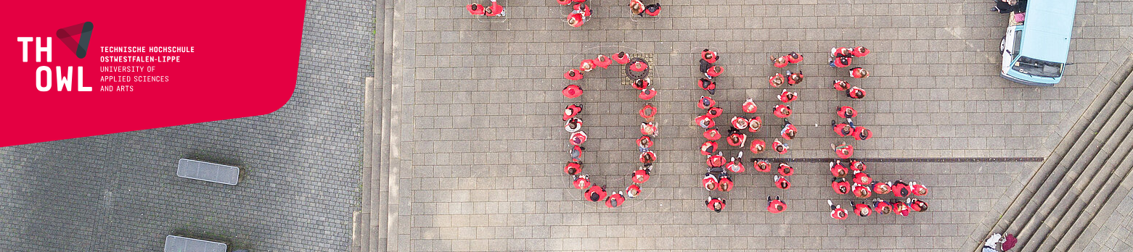
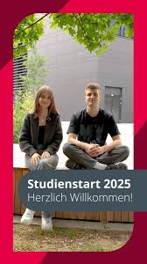
Welcome Week

Slide 29
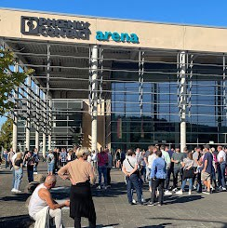
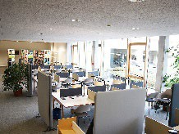
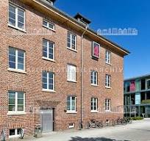
Welcome week DT 2025 - Exchange students - Internationals
 | 22. September 2025
central Welcome Ceremony in Lemgo |  | up 08.15 meeting on campus Detmold up 8.30 travel by bus to Lemgo 11. 00 Welcome ceremony in the Phoenix Contact Arena 12.19 | 13.19 | 14.19 back by bus depending on your program in Detmold | Detmold to Lemgo | Internationals go by bus to Lemgo to the welcome ceremony (accompany by one of the Detmold Buddies and IO DT) Participation at the welcome ceremony Come back by bus to Detmold
if necessary visit the Detmold Library for technical issues with the IT services |  | 14.00 – 15.00 | Library on campus DT if necessary Alternative visit it at 9 am on 23rd September or better before semester start | Check that all basic settings for IT equipment are available for each student.
Exchange Students Architecture – Interior Architecture – Meeting with Sandra Bomholt (sandra.bomholt@th-owl.de) |  | 15.00 – 16.00 | Room 4.108 | FB1 exchange students will discuss the projects, WPF and cumulative courses offered by FB1 and receive an introduction to online booking at the next day

Slide 30
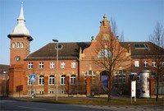
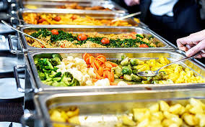

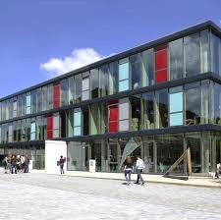
Welcome week DT 2025 - Exchange students - Internationals
 | 23. September 2025
Welcome Ceremonies in Detmold Programs here: https://www.th- owl.de/studienstart/fachbereiche/ |  | 9.30 – 11.30 FB1 Architecture and co 9.00 – 9.45 FB3 Civil Engineering 9.30 – 10.30 FB2 Media production | Casino room 3.103 Casino room 3.107 Room 7.121 | The faculties welcome all new students
Welcome Ceremony IO in Detmold |  | 11.30 – 12.15 | Casino room 3.103 | The IO welcomes all new Internationals and bring you together
Lunch in the canteen |  | 12.15 – 13.00 | Canteen Building 2 | Enjoy your lunch
Campus tours with Torben from the student committee |  | 13.00 | Meeting at the Student committee (Fachschaft) blue truck located in front of the canteen | The internationals join the student committee for a guided campus tour in English to explore key locations FB1, FB2 and FB3.
Exchange Students Architecture – Interior Architecture – Online Booking selection of projects Architecture and Interior architecture Sandra Bomholt (sandra.bomholt@th-owl.de) |  | 14.00 – 15.00 | Room 4.108 | FB1 exchange students book their selected projects, WPF and cumulative projects online with the guidance and support of Sandra’s Student assistant and the Detmold Buddies.

Slide 31
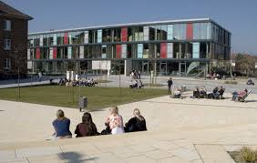

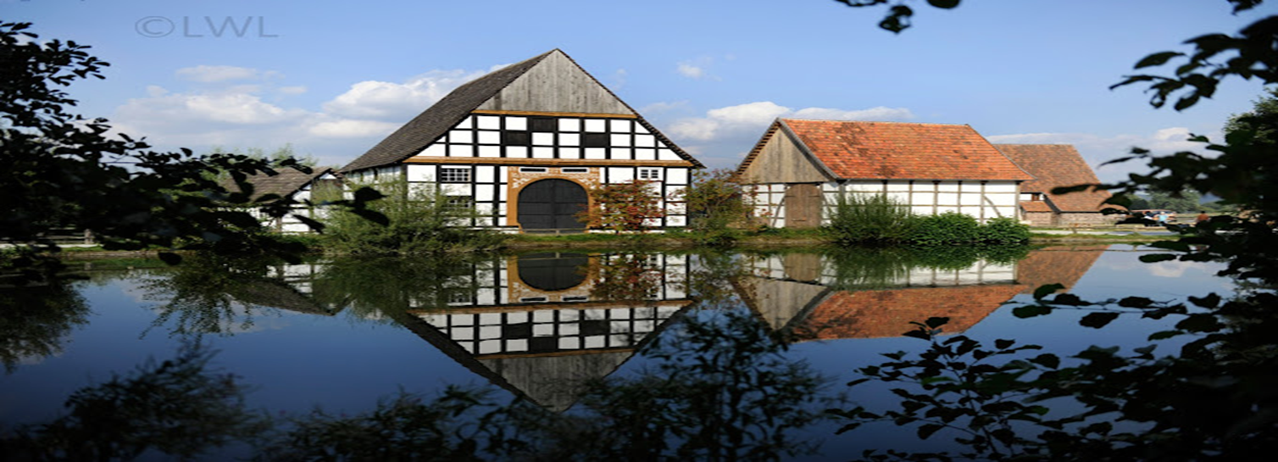

Welcome week DT 2025 - Exchange students - Internationals
Participation at the welcome program from your faculty Programs here: https://www.th- owl.de/studienstart/fachbereiche/ | 24. September 2025 9.00 – 18.00 17.00 – 19.00 19.00 - .. | Challenges Barbecue on campus Pub crawl in Detmold
 | 25. September 2025
Participation at the welcome program from your faculty Programs here: https://www.th- owl.de/studienstart/fachbereiche/ | 12.30 – 14.00 15.00 – 19.00 20.00 – 22.00 | Barbecue on campus City Rallye Open air cinema
 | 26. September 2025
Exchange Students Architecture – Interior Architecture – Results of the applications for projects - publication of the lists |  |  | Online / individual emails Sandra Bomholt (sandra.bomholt@th-owl.de) | Sandra Bomholt informs everybody about participation in the project, electives, excursions to the FB1 students
Getting Connected - A Day Out |  | 10.15-15.00 | Campus – open air museum Detmold Application by email to internationaloffice@th-owl.de First come first served | first social event while exploring Open Air Museum in Detmold in a guided tour to learn more about German local culture and history. Share a casual lunch and connect with fellow students in a relaxed atmosphere.
Soapbox racing |  | 11.00 – 14.00 | On Campus | Soapbox racing on Campus with the soapbox you built with your team
Party |  | 21.00 – 00.00 | On Campus - Casino | Celebrate the end of welcome week with a party with your new friends.

Slide 32
Bus transfer from Detmold to Lemgo on 22.09.2025
We are offering to take you by bus to the central welcome ceremony in Lemgo on September 22, 2025. If you would like to travel with us, please click on the time that suits you and confirm your participation. we will meet on campus Detmold by the entrance of building 2 and go together to the bus station at the train station
Please confirm your participation here:
https://terminplaner6.dfn.de/de/p/1d7c6c3858fd8b21fd5af60e61ea3c82-1385311

Slide 33
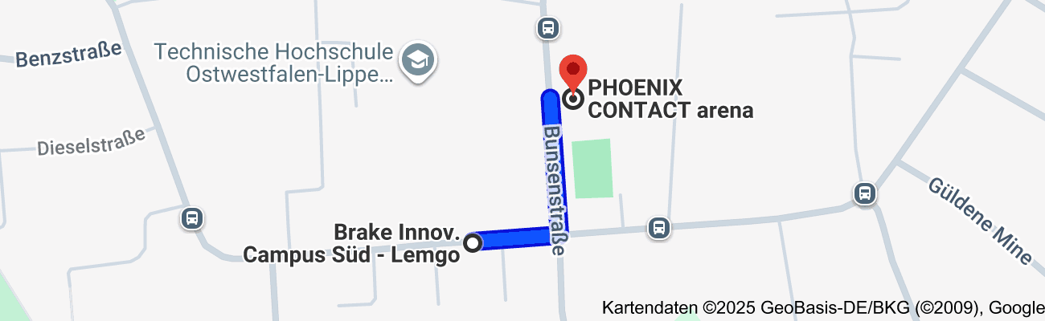
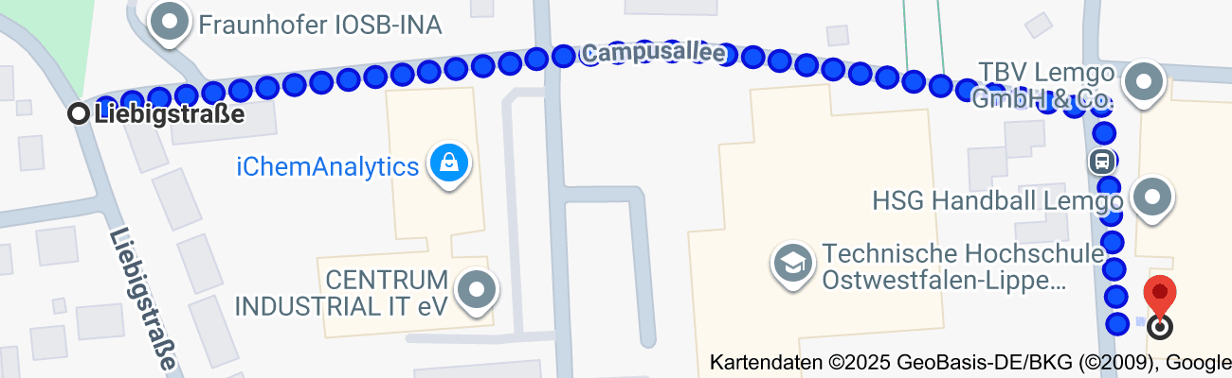
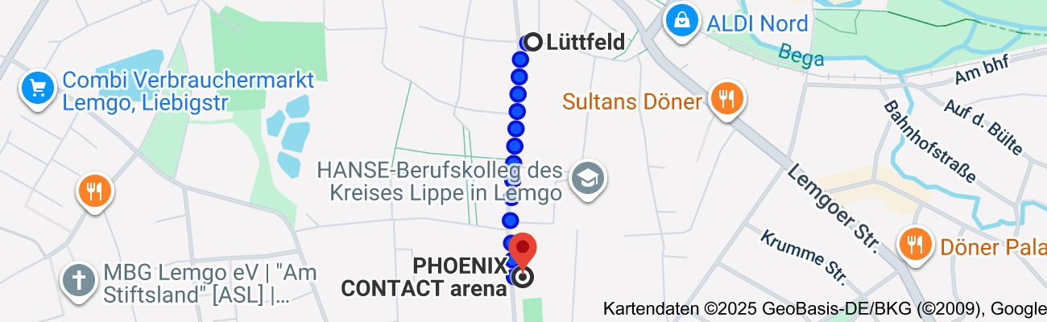
Detmold to Lemgo | 44 minutes trip
TH-OWL - Detmold Campus | 13 minutes walk | Detmold Bahnhof | Bus 790 | Brake Innov. Campus Süd - Lemgo | 4 minutes walk | TH-OWL - Lemgo Campus
------------------------------------------------------------>----------------------------------------------------------------->----------------------------------------------------------------------->-----------------------------------------------------
Departure | Destination | Departue time | Arrival time | no. of transfers | Trip Time (min) | Transportation | Frequency | First Bus Departure | Last Bus Departure*
Detmold Bahnhof | Brake Innov. Campus Süd - Lemgo | 8:45 AM | 9:07 AM | 0 | 00:22 | Bus No. 790 campus express | Occurs every hour | 8:45 AM | 3:45 PM
 |  | 9:45 AM | 10:07 AM | 0 | 00:22 | Bus No. 790 campus express | Occurs every hour
Detmold Bahnhof | Lemgo Liebigstraße | 8:30 AM | 8:57 AM | 0 | 00:27 | Bus No. 790 | Occurs every hour | 5:30 AM | 10:05 PM
 |  | 9:30 AM | 9:57 AM | 0 | 00:27 | Bus No. 790 | Occurs every hour
Detmold Bahnhof | Lemgo Lüttfeld | 9:05 AM | 9:31 AM | 0 | 00:26 | Bus No. 790 | Occurs every hour | 5:54 AM | 7:05 PM
 |  | 10:05 AM | 10:31 AM | 0 | 00:26 | Bus No. 790 | Occurs every hour
Lemgo to Detmold | 39 minutes trip
TH-OWL - Lemgo Campus | 4 minutes walk | Brake Innov. Campus Süd - Lemgo | Bus 790 | Detmold Bahnhof | 13 minutes walk | TH-OWL - Detmold Campus
------------------------------------------------------------>----------------------------------------------------------------->----------------------------------------------------------------------->-----------------------------------------------------
Departure | Destination | Departue time | Arrival time | no. of transfers | Trip Time (min) | Transportation | Frequency | First Bus Departure | Last Bus Departure*
Brake Innov. Campus Süd - Lemgo | Detmold Bahnhof | 12:20 PM | 12:42 PM | 0 | 00:22 | Bus No. 790 campus express | Occurs every hour | 8:20 AM | 4:20 PM
 |  | 1:20 PM | 1:42 PM | 0 | 00:22 | Bus No. 790 campus express | Occurs every hour
Lemgo Liebigstraße | Detmold Bahnhof | 1:01 PM | 1:29 PM | 0 | 00:28 | Bus No. 790 | Occurs every hour | 5:56 AM | 9:40 PM
 |  | 2:01 PM | 2:29 PM | 0 | 00:28 | Bus No. 790 | Occurs every hour
Lemgo Lüttfeld | Detmold Bahnhof | 1:26 PM | 1:54 PM | 0 | 00:28 | Bus No. 790 | Occurs every hour | 5:26 AM | 9:26 PM
 |  | 2:26 PM | 2:54 PM | 0 | 00:28 | Bus No. 790 | Occurs every hour
* | Last bus departure refers to direct bus from Brake Innov. Campus Sud in Lemgo to The Bahnhof in Detmold, other alternatives can be found on the DB navigator App
 | Nota: | The Bus might stop at | Braker Weg Lemgo | instead, the walking time to Lemgo campus will be 10 minutes
 | updated and exact timing to be checked by students on the same day depending on possible traffic and bus delays
 |  |  |  | Download Link

Slide 34


Getting Connected - A Day Out
Enjoy our first social event while exploring our local Open Air Museum in Detmold in a guided tour to learn more about German culture and history. Share a casual lunch and connect with fellow students in a relaxed atmosphere. Friday, 26 September 2025
10.15-15.00
Meeting on campus
Walking together to the Open Air Museum in Detmold
www.th-owl.de/international

Slide 35
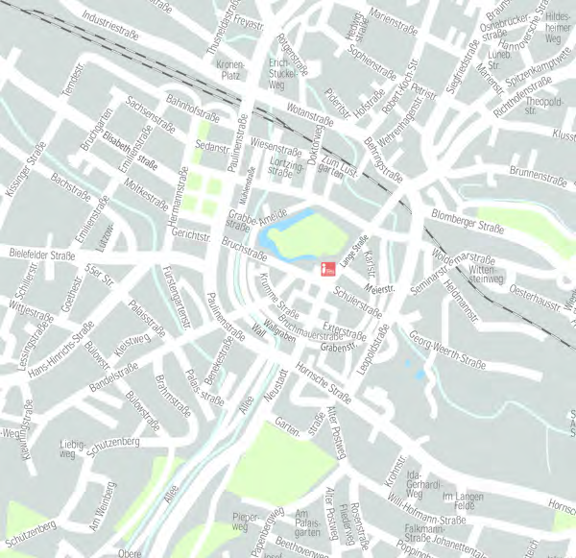
What to do in Detmold
bars & partys
eat and drink
leisure activities
groceries and other things

Slide 36
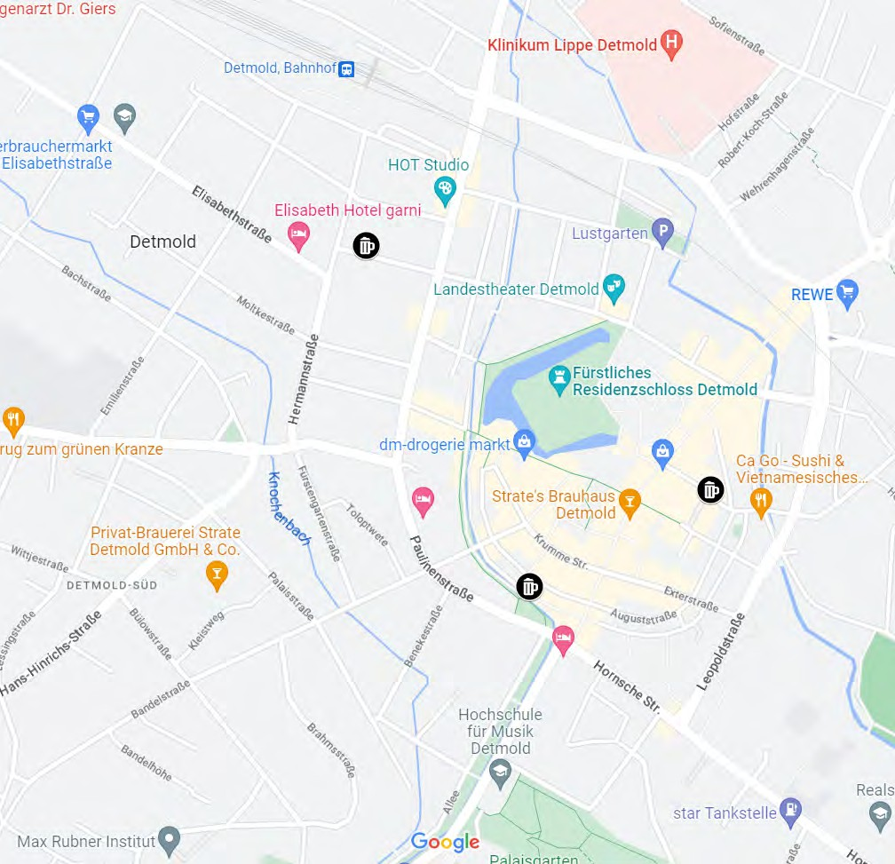

Bars + Partys
Paraplü
DARÜ
Café Mix
M‘s Club
Hermann‘s Club

Slide 37
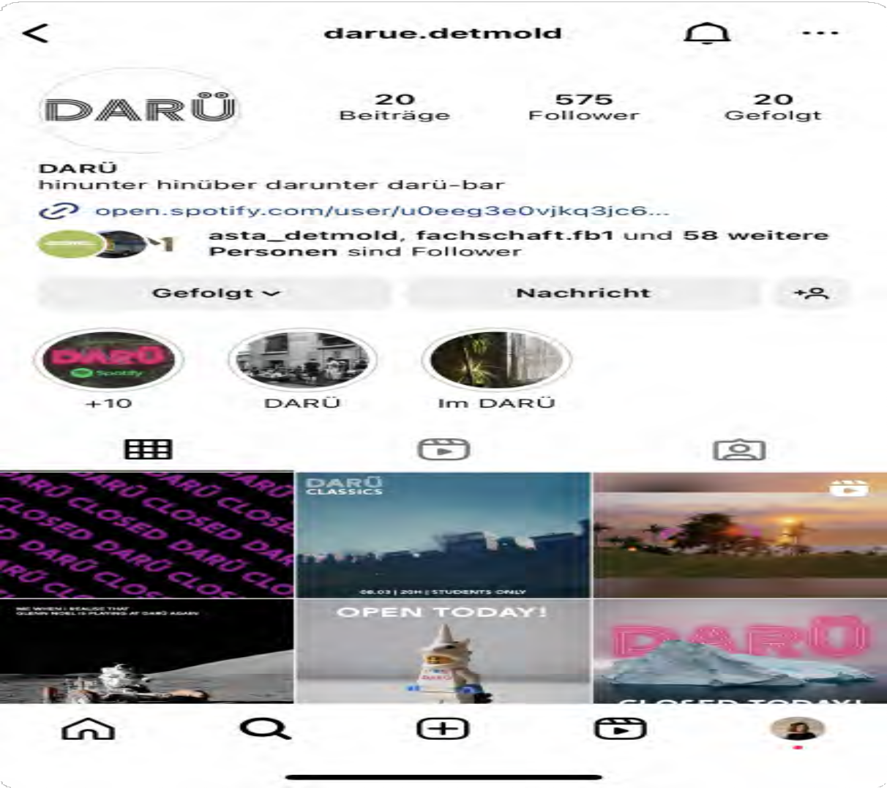
Best student bar on wednesdays:
DARÜ
Students only
Organised by the Fachschaft FB1
Follow on Instagram @darue.detmold to always know about upcoming events!

Slide 38
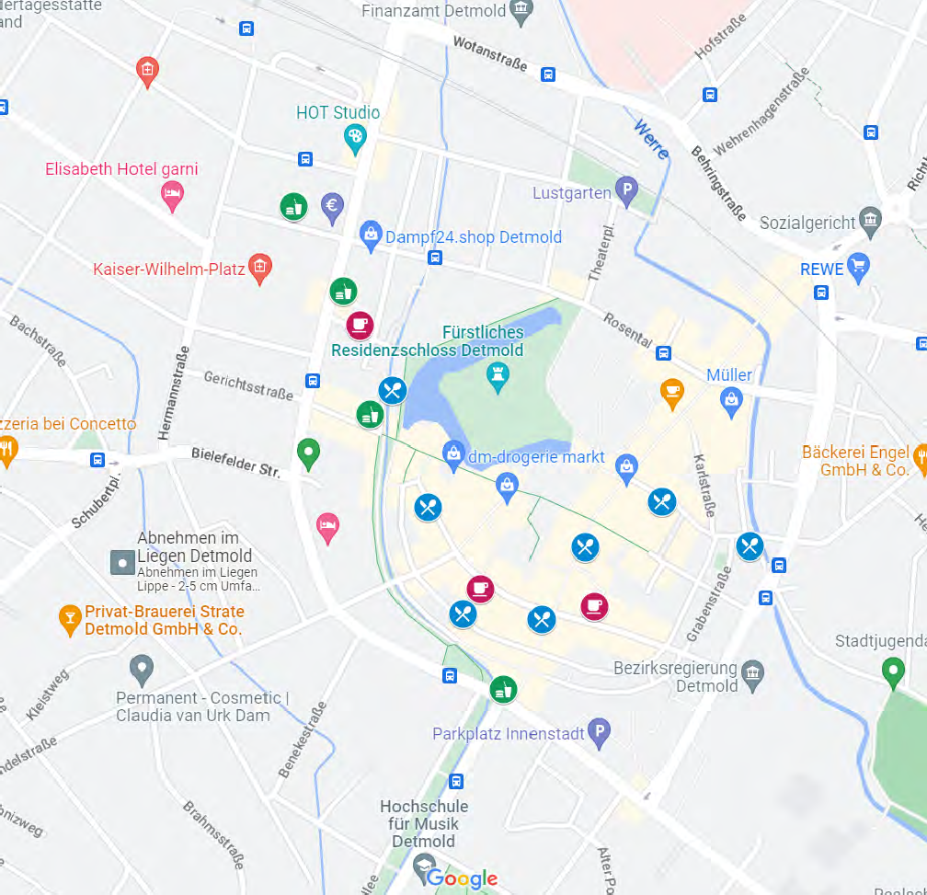
food + drinks
Cafés
Halbstark
Café Cup
Verve Café
Restaurants
Strate‘s Brauhaus (German)
Ristorante Buongiorno (Italian)
Ca Go (Vietnamese)
Zou (Vietnamese)
Bao Ngoc (Vietnamese)
Pizzeria Meier 9 (Italian)
Concetto (Italian)
Sticky Rice (Sushi)
Taste of India (Indian)
Döner, Falafel, Fast Food, ...
Kebabadin
Seval Grill
Hahnenteller
BurgerMe
RedJerry

Slide 39

Groceries
Groceries
Combi
REWE
Edeka
Petersilchen (bio, organic)
Drugstores
dm
Rossmann
Müller

Slide 40

Leisure activities
Detmold castle
Theatre (flatrate)
you can visit as many shows as you want at the Landestheater Detmold. What do you have to do for this?:
Book a ticket three days before the performance under the keyword 'Theaterflatrate' - in person at the box office at the theater or by phone at 05231/974 803 and pick up the tickets until 15 minutes before the start of the performance
City museum
Walking to the Hermann Denkmal
Externsteine
Public swimming (Aqualip, …)
Bowling
flea market (every first saturday of the month between April and October)

Slide 41

map QR-code
https://www.google.com/maps/d/edit?mid=1sxcIU6oZeHWITIzzIp1_QkOO8jBbevI&usp=sharing

Slide 42
Thank You!
Please feel free to ask questions by raising your hand or in the chat ☺

Slide 43
Thank you for your attention
We wish you a wonderful time in Detmold

