Slide 1
Welcome at TH OWL
Visa
Arrival and Living in OWL
Settling in Ostwestfalen-Lippe
Notes:
Session 21/08/2024

Slide 2

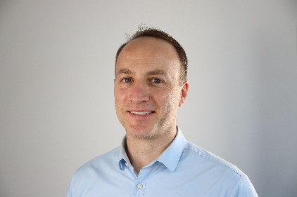
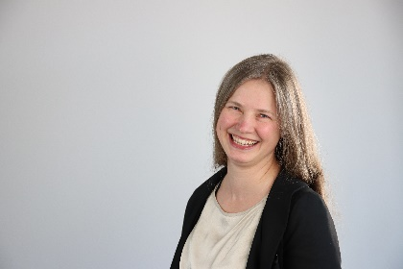
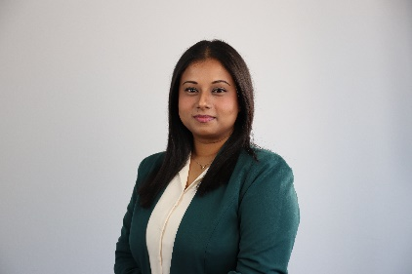
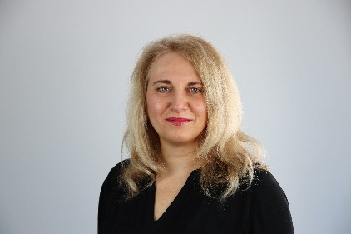
International Office
James O'Reilly
Head International Office
Anne Kulasi
Erasmus Coordinator
Ananya Nagendran
International Career Services
Coordinator QualifyING
Anamaria Capsa
Coordinator for Refugee Program NRWege and Welcome

Slide 3
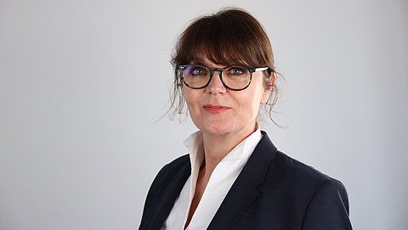
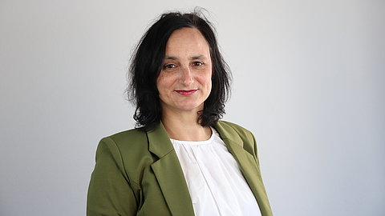
Maryse Niemeier
Kerstin Rosemann
Campus Detmold
Consultant Outgoing/Incoming
Room 4.109 – „Bülow Block“
Phone +49 5231 7696091
E-Mail: maryse.niemeier@th-owl.de
On campus: Tues – Thurs: 9.00 – 13.00 h
Home office: Mon - Fri
Campus Lemgo & Höxter
Consultant Incoming
Room 1.117
Phone +49 5261 702 5836
E-Mail: kerstin.Rosemann@th-owl.de
On campus: Mon & Thu: 9.00 – 15.00 h
Home office: Tue, Wed and Fri

Slide 4
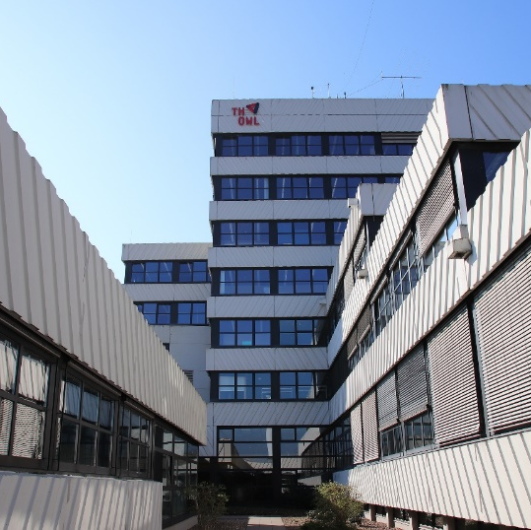
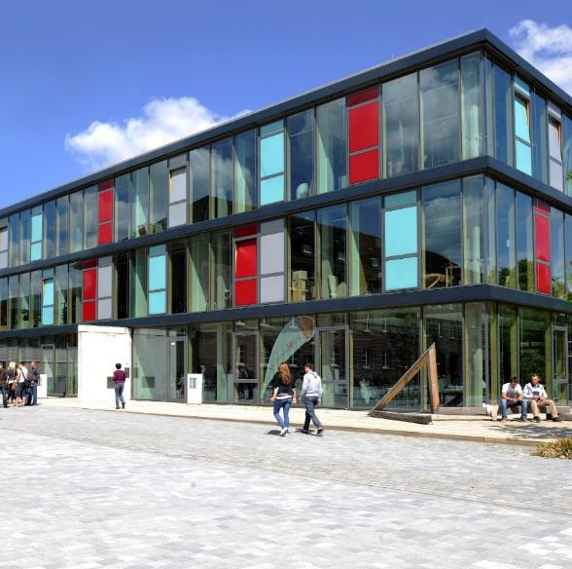
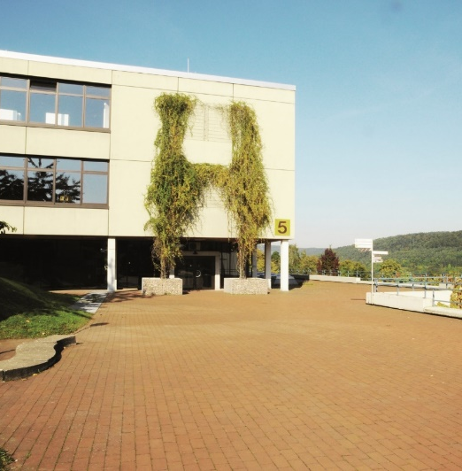
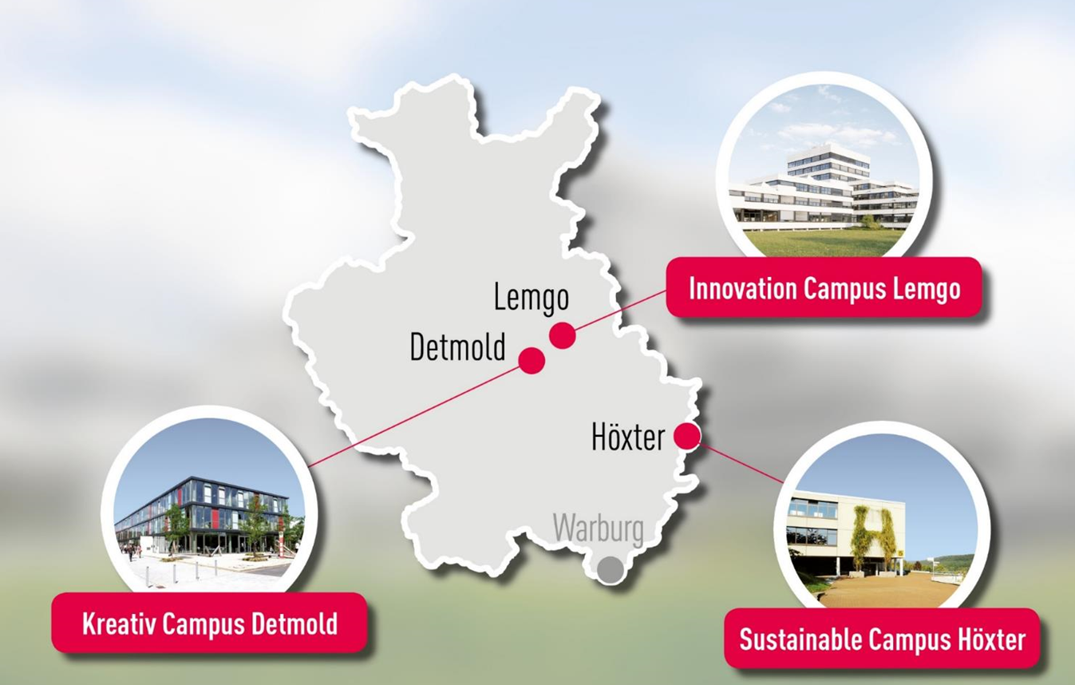
3 Locations
Lemgo
Detmold
Höxter

Slide 5


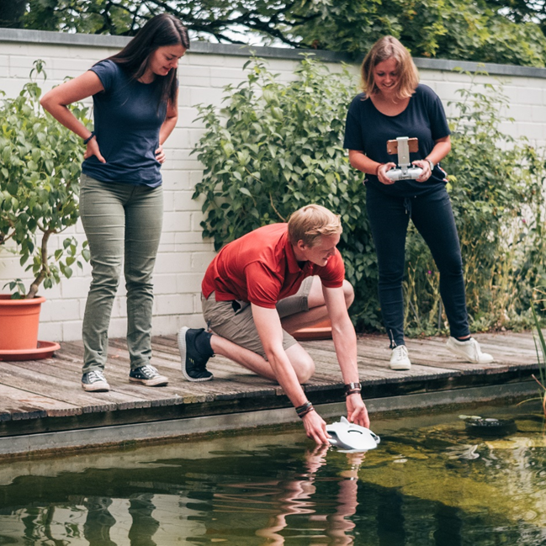
Departments
Creative Campus Detmold
  Detmold School for Architecture and Interior Design
  Civil Engineering
  Media Production
  Innovation Campus Lemgo
  Life Science Technologies
  Electrical Engineering and Computer Science
  Mechanical Engineering and Mechatronics
  Production Engineering and Wood Technology
  Business Administration and Economics
  Sustainable Campus Höxter
  Environmental Engineering and Applied Computer Science
  Landscape Architecture and Environmental Planning

Slide 6
Visa

Slide 7

Late Arrival – what consequences to face
Your admission notification for the Summer term will be valid to enrol in the winter semester 2025/26. Enrolment will be possible starting from 2 May 2025.
If you want to chose this option, send me an email for receiving detailed explanation of the process.
Latest date of arrival for starting your study program in Summer term 2025:
MIT: 22 April
MAE: 02 April
In case you will not be able to be here on time, it is not recommended to enrol.

Slide 8
Enrolled but no arrival on time possible – what consequences to face
What options do you have if you cannot arrive by the latest date of arrival:
  Option 1:
    Withdraw your enrolment
    Deadline: 31.08 resp. 28./29.02.
      = full re-imbursement
  Option 2:
    Stay enrolled until a later arrival at your own responsibility.
    No obligation in being personally present.
    Discuss this option with your faculty
    = the full semester dues!
  Consequences:
    pay all monthly health insurance contributions as of your day of enrolment.
    Payments cannot be reimbursed (exception: you miss the complete term!)
    No reset of semesters

Slide 9
Arrival and Living in Ostwestfalen- Lippe

Slide 10
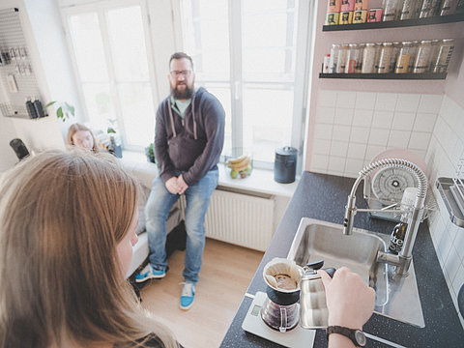
Living in OWL –
Housing
Student dorm of Studierendenwerk Bielefeld - Registration: https://tl1host.eu/SWBI/#home
Student dorm of Landesverband Lippe for Lemgo and Detmold: a.meier@landesverband-lippe.de
Student dorm Höxter
Private platforms
  https://www.kleinanzeigen.de/s-auf-zeit-wg/detmold/zimmer/k0c199l1792
  https://www.wg-gesucht.de/en/wg-zimmer-in-Detmold.25.0.1.0.html
  Facebook page TH OWL das Völkchen. The rentals are advertised in part by our students.
List of alternative housing options in OWL:
  https://www.th-owl.de/studium/studienstart/wohnen-in-owl/
  Wohnangebotsliste.

Slide 11
Living in OWL –
Housing
BGW – Bielefeld
Room rent 220 Euro 4 rooms (shared apartment)
Room rent 250 Euro 3 rooms (shared apartment)
Room rent is 280 Euro 2 rooms (shared apartment)
Website: BGW Bielefeld
Phone: +49 521 8809-01
Email: info@bgw-bielefeld.de
Office Address: Carlmeyerstraße 1, 33613 Bielefeld, Germany
Mentioning that you’re a student at TH OWL when making inquiries can sometimes help prioritize your application

Slide 12
Living in OWL –
Housing
join the international WhatsApp group
connect with other students
discuss shared apartment options,
exchange tips on finding a place,
learn about available apartments or sublets
TH OWL International group : https://chat.whatsapp.com/HOH8v0668qMEpzsPjPVPVV

Slide 13

Destination OWL
Flight to Germany (most likely Frankfurt Int. Airport)
Continue with Deutsche Bahn:
  To Detmold: DB Schedule
  To Lemgo: DB Schedule
  To Höxter: DB Schedule
Usage of „Deutschlandticket“:
all busses, trams, underground as well as regional trains (S-Bahn, RegionalBahn, RegionalExpress) 2. class.
The usage of high speed trains (ICE, IC/EC) or private companies (Flix) are excluded.
Get your semesterticket download on App „owlMobil“ (detailed info on our SKIM website)

Slide 14
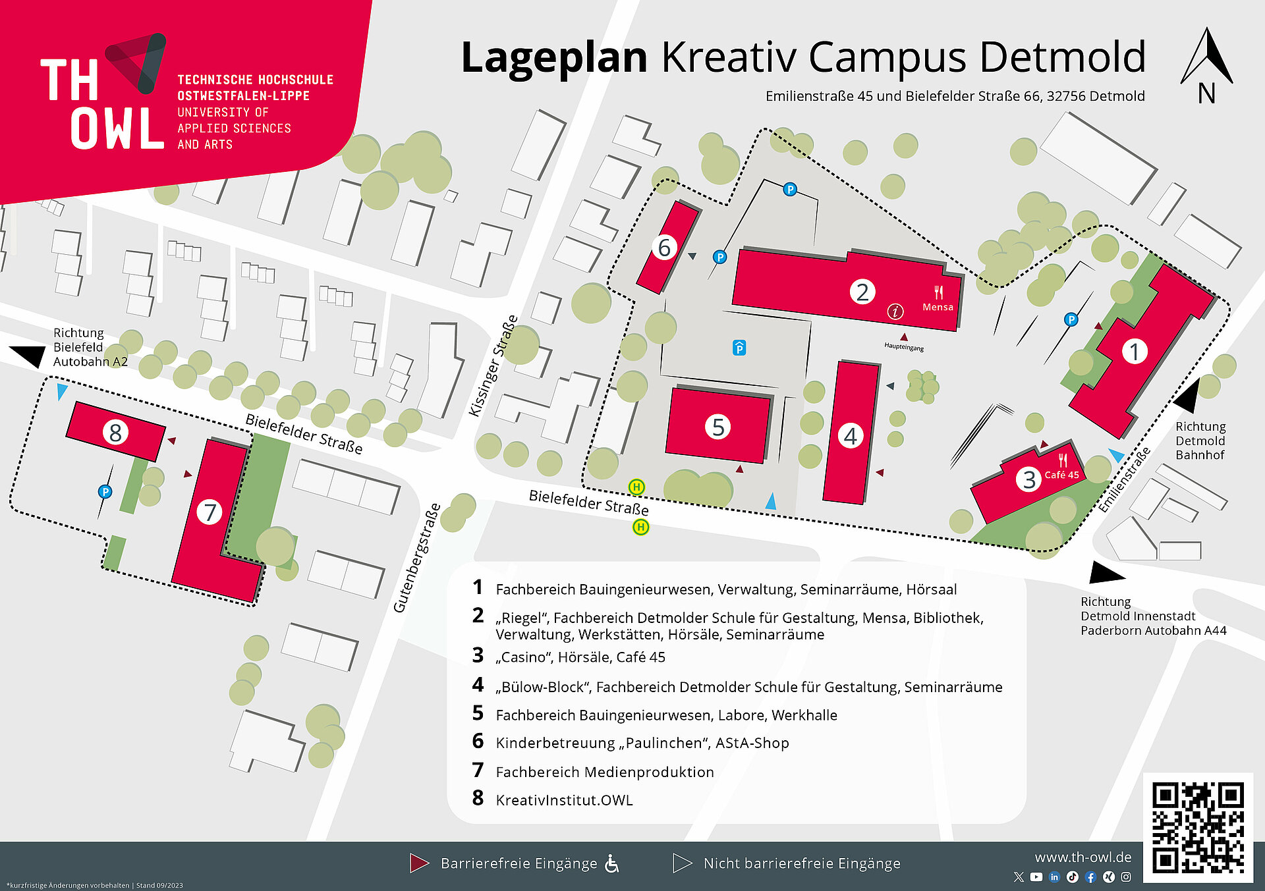
Technische Hochschule Ostwestfalen-Lippe
Emilienstraße 45
Tel.: +49 5231 769 0
32756 Detmold

Slide 15
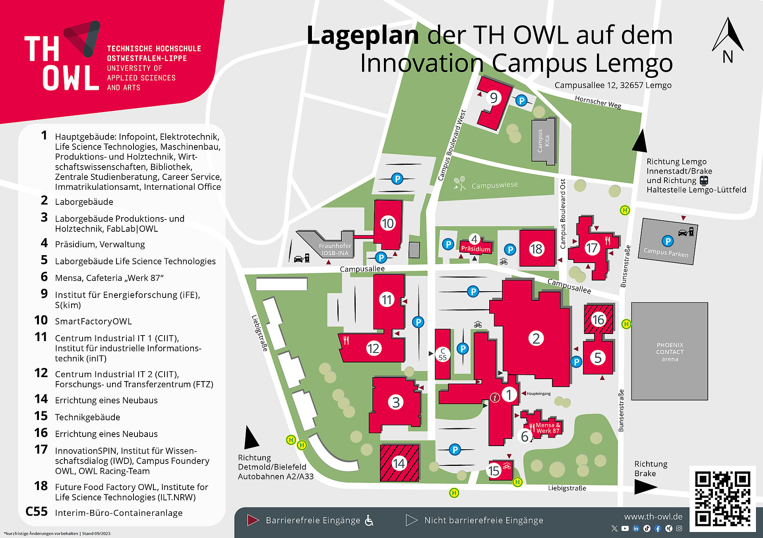
Technische Hochschule Ostwestfalen-Lippe
Campusallee 12
Tel.: +49 5261 702 0
32657 Lemgo

Slide 16
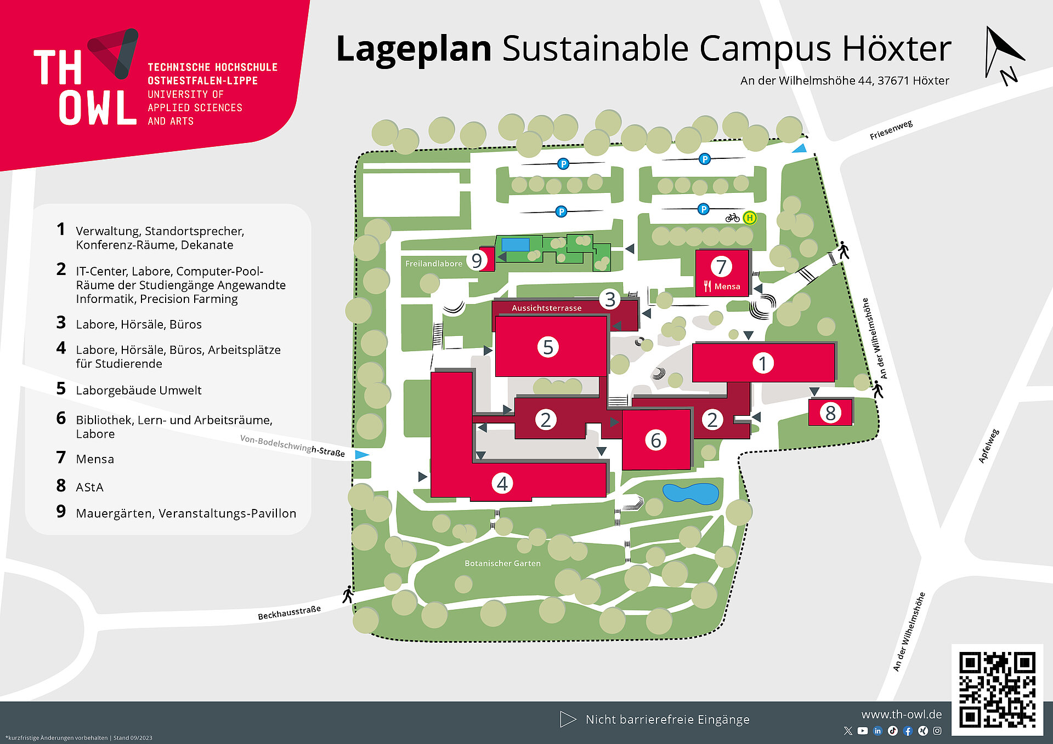
Technische Hochschule Ostwestfalen-Lippe
An der Wilhelmshöhe 44
Tel.: +49 5271 687 0
37671 Höxter

Slide 17
Settling in OWL

Slide 18
First steps in town and on campus
City Registration and Residence permit:
register within 2 weeks at the town hall
present a so-called „Wohnungsgeberbestätigung“ filled by your landlord:
    Wohnungsgeberbestätigung
apply for your electronic residence permit for NON-EU students.
receive an email invitation by the immigration office incl. a list of documents to present
Activate your bank account:
upon arrival (present your student card and the confirmation of city registration)

Slide 19

International Office Program
Buddy Program
Social Engagement Program
Contact our Buddy Team

Slide 20
Overview of semester events
Please check out our upcoming events in our
International Student Guide

Slide 21
Thank You!
Please feel free to ask questions by raising your hand or in the chat ☺

